Slide 1


Value Orchestration Canvas
ANDREW SMART
October 2025

Slide 3
VALUE orchestration CANVAS (VOC)
ENABLERS
EXECUTION
VALUE
BRAND
CULTURE
TECHNOLOGY
PROCESSES
PRODUCTS & SERVICES
ANNUAL RESULTS
STRATEGIC GOALS
REPUTATION
Corporate Brand
Employee Brand
Customer Brand
Third Party Brand
Investor Brand
ESG Brand
Values
Mindset
Leadership
Behaviours
Data
Infrastructure
Code
Applications
Information
Effectiveness
Efficiency
Quality
Resilience
Portfolio Fit
Delivery
Experience
Quality
Financial
Non-Financials
Financial
Non-Financials
Corporate Reputation
Employee Reputation
Customer Reputation
Third Party Reputation
Investor Reputation
ESG Reputation
CHANGE
Improve
Change
Transform
PEOPLE
THIRD PARTIES
Skillset
Roles
Performance
Contracts
Integration
Relationships
INNOVATION
Pipeline
Capability
Velocity
Resources
ECOMONICS
FINANCIALS
BUSINESS MODEL
EXTERNAL ENVIRONMENT
GOVERNANCE
Costs
Revenue
Profit
Capital
Liquidity
Financial Accuracy
Value Creation
Value Delivery
Value Capture
Value Drivers
Context
Forces
Industry
Dynamics
Decision-Making
Accountability
Transparency
Compliance

Slide 4
Voc Taxonomy Structure
Perspective (Strategy, Strategy Execution, Risk Management)
Domain
Dimension
Element
Sub-element

Slide 5
VOC TAXONOMY
PERSPECTIVES
DOMAINS
DIMENSIONS
Strategy
Strategy Execution
Risk Management
Risk Appetite
OKRs
KPIs
Economics
Enablers
Execution
Value
Financials
Business Model
External Environment
Governance
Brand
Culture
People
Technology
Third Parties
Innovation
Change
Processes
Products & Services
Annual Results
Strategic Goals
Reputation

Slide 6
Voc Taxonomy
Domains
Economics
Enablers
Execution
Value
Dimensions
Financials
Business Model
External Environment
Governance
Brand
Culture
People
Technology
Third Parties
Innovation
Change
Processes
Products & Services
Annual Results
Strategic Goals
Reputation

Slide 7
VALUE orchestration CANVAS (VOC)
ENABLERS
EXECUTION
VALUE
BRAND
CULTURE
TECHNOLOGY
PROCESSES
PRODUCTS & SERVICES
ANNUAL RESULTS
STRATEGIC GOALS
REPUTATION
1
2
4
6
9
10
11
12
CHANGE
7
PEOPLE
THIRD PARTIES
3
5
INNOVATION
8
ECOMONICS
FINANCIALS
BUSINESS MODEL
EXTERNAL ENVIRONMENT
GOVERNANCE
1
2
3
4

Slide 8
VALUE orchestration CANVAS (VOC)
ENABLERS
EXECUTION
VALUE
BRAND
CULTURE
TECHNOLOGY
PROCESSES
PRODUCTS & SERVICES
ANNUAL RESULTS
STRATEGIC GOALS
REPUTATION
CHANGE
PEOPLE
THIRD PARTIES
INNOVATION
ECOMONICS
FINANCIALS
BUSINESS MODEL
EXTERNAL ENVIRONMENT
GOVERNANCE

Slide 9
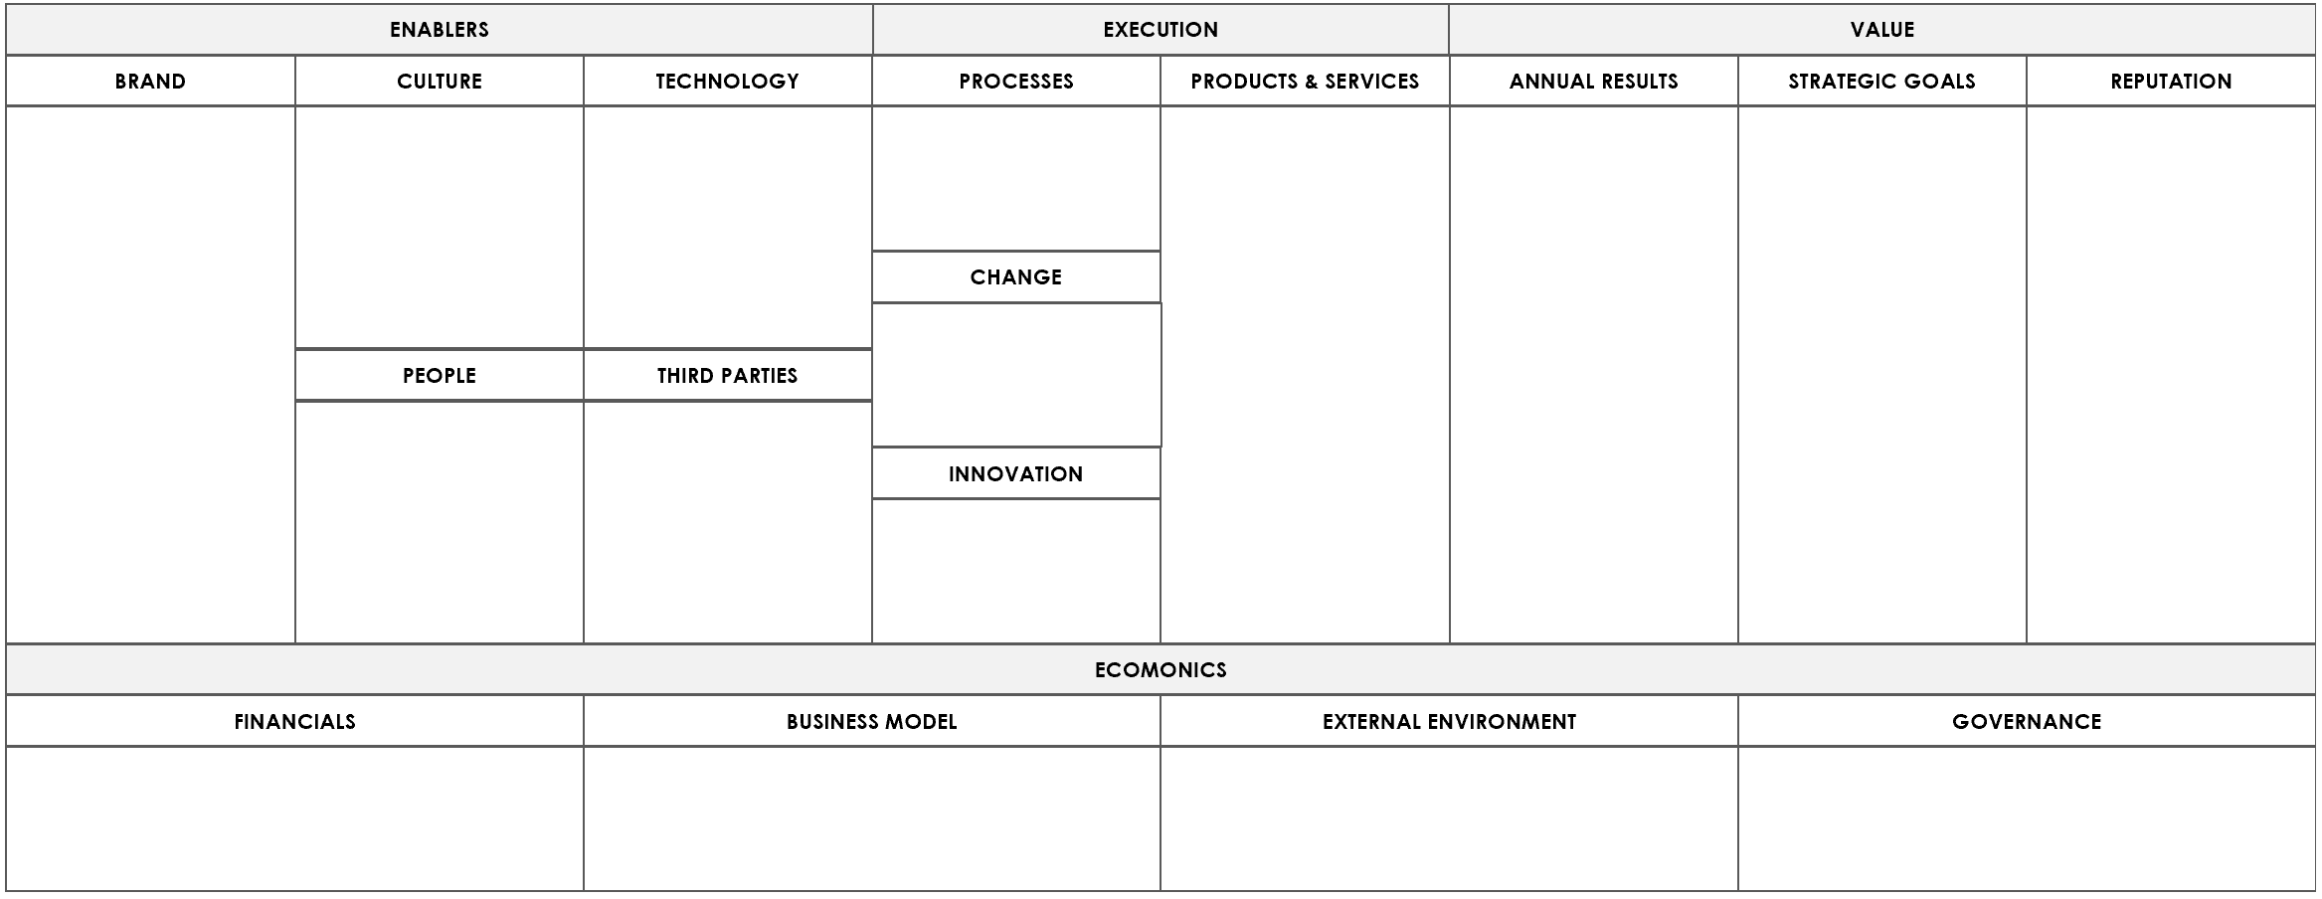

Slide 10
Value Orchestration Canvas
Economics
Financials
Business Model
Enablers
Culture
Execution
Value
External Environment
Governance
People
Technology
Third Parties
Processes
Change
Innovation
Annual Results
Strategic Results
Reputation

Slide 11
Value ORCHESTRATION TAXONOMY
Value Orchestration
ECONOMICS
ENABLERS
EXECUTION
VALUE
Financials
Business Model
External Environment
Governance
Brand
Culture
People
Technology
Third Parties
Processes
Change
Innovation
Products & Services
Annual Results
Strategic Results
Reputation

Slide 12
Value ORCHESTRATION TAXONOMY
Value Orchestration Canvas
ENABLERS
EXECUTION
VALUE
Brand
Culture
People
Technology
Third
Parties
Processes
Change
Innovation
Products
& Services
Annual Results
Strategic Results
Reputation
ECONOMICS
Financials
Business Model
External Environment
Governance

Slide 13
Value ORCHESTRATION TAXONOMY
VALUE ORCHESTRATION CANVAS
ECONOMICS
ENABLERS
EXECUTION
VALUE
Financials
Business Model
External Environment
Governance
Brand
Culture
People
Technology
Third Parties
Processes
Change
Innovation
Products & Services
Annual Results
Strategic Results
Reputation

Slide 14
Cause & Effect 1 - OUR PROMISE VS THE REALITY
BRAND
REPUTATION
Corporate Brand
Employee Brand
Customer Brand
Third Party Brand
Investor Brand
ESG Brand
Corporate Reputation
Employee Reputation
Customer Reputation
Third Party Reputation
Investor Reputation
ESG Reputation

Slide 15
Cause & Effect 1
Brand (Our Promise) > Orchestration of Value Creation Activities > Reputation (The Reality)

Slide 16
Cause & Effect 2
ENABLERS
EXECUTION
VALUE
ECONOMICS

Slide 17
Cause & Effect 2
Enablers to Execution to Value underpinned by the firm economics

Slide 18
Cause & Effect 3
ENABLERS
EXECUTION
VALUE
BRAND
CULTURE
TECHNOLOGY
PROCESSES
PRODUCTS & SERVICES
ANNUAL
STRATEGIC
REPUTATION
CHANGE
PEOPLE
THIRD PARTIES
INNOVATION
ECOMONICS
FINANCIALS
BUSINESS MODEL
EXTERNAL ENVIRONMENT
GOVERNANCE

Slide 19
Cause & Effect 3
Domain Flow, Alignment and Orchestration

Slide 20
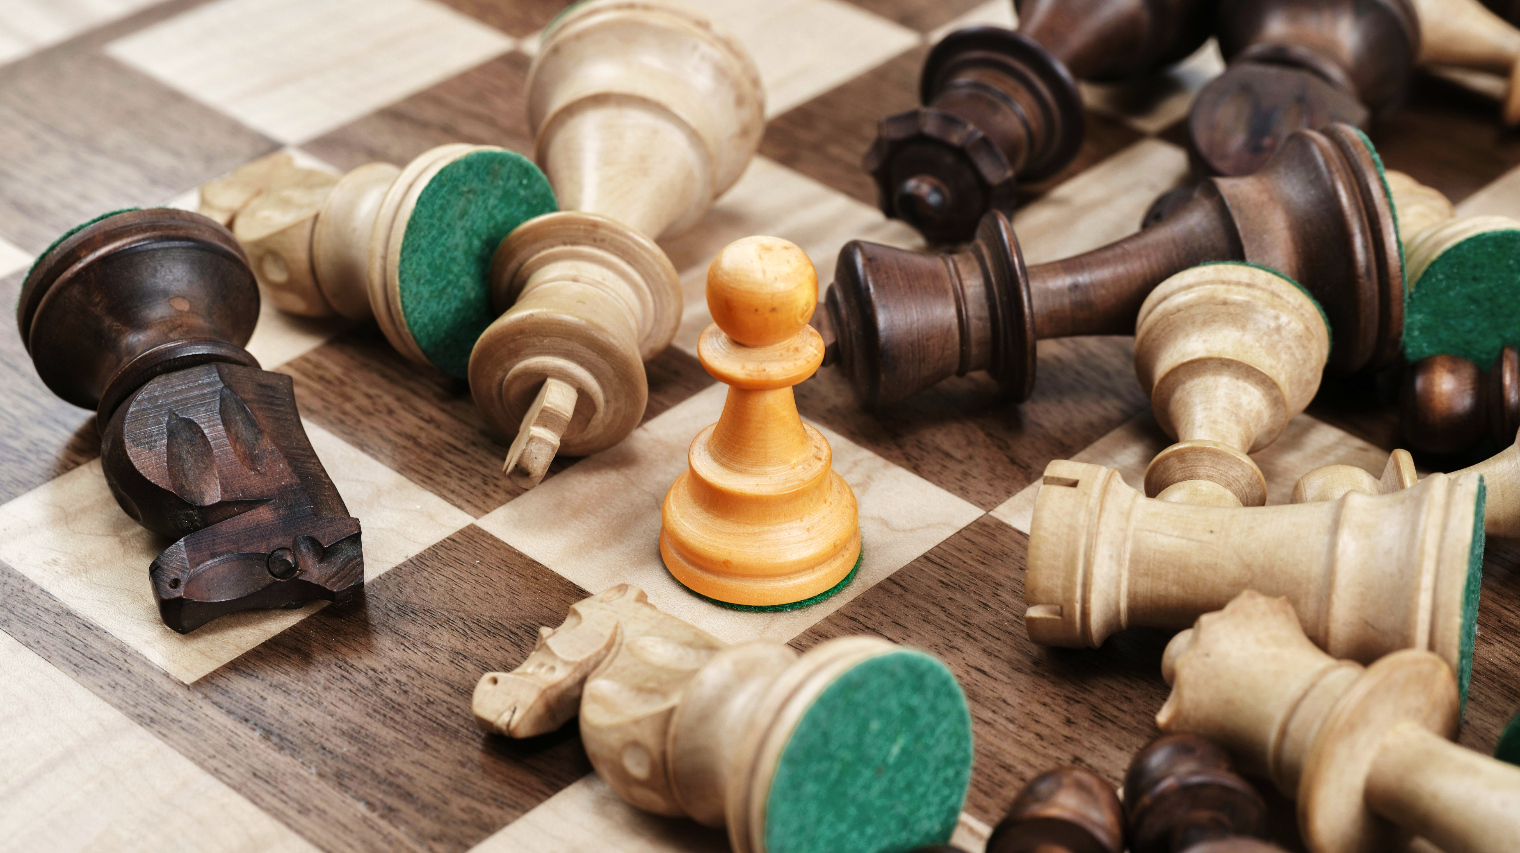
CLARITY IN UNCERTAINTY

Slide 21
CLARITY IN UNCERTAINTY

